Slide 1
Component | URL | Purpose
Airflow | http://localhost:8080 | Orchestrate ML pipelines (train → evaluate → deploy)
MLflow | http://localhost:5000 | Track experiments, models, and metrics
Model Service (Flask) | http://localhost:8000/apidocs | Swagger UI for model predictions
Prometheus | http://localhost:9090 | Collect metrics (latency, requests, etc.)
Grafana | http://localhost:3000 | Visualize metrics from Prometheus
Jenkins | http://localhost:8081 | CI/CD pipeline automation

Slide 2
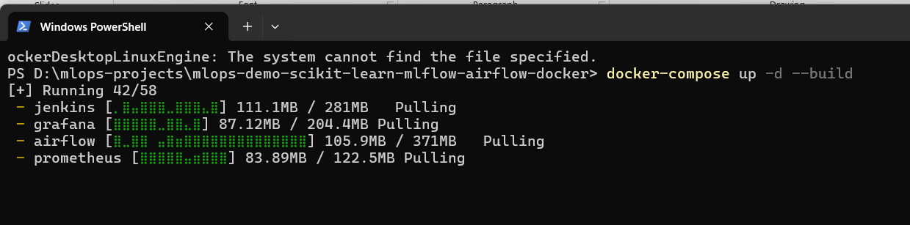

Slide 3
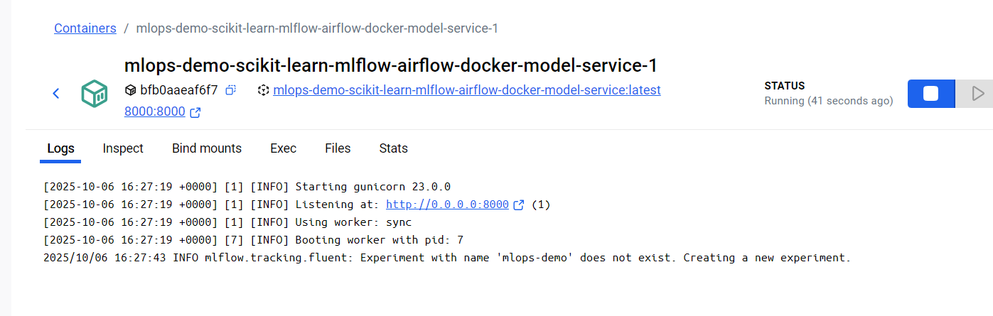

Slide 4
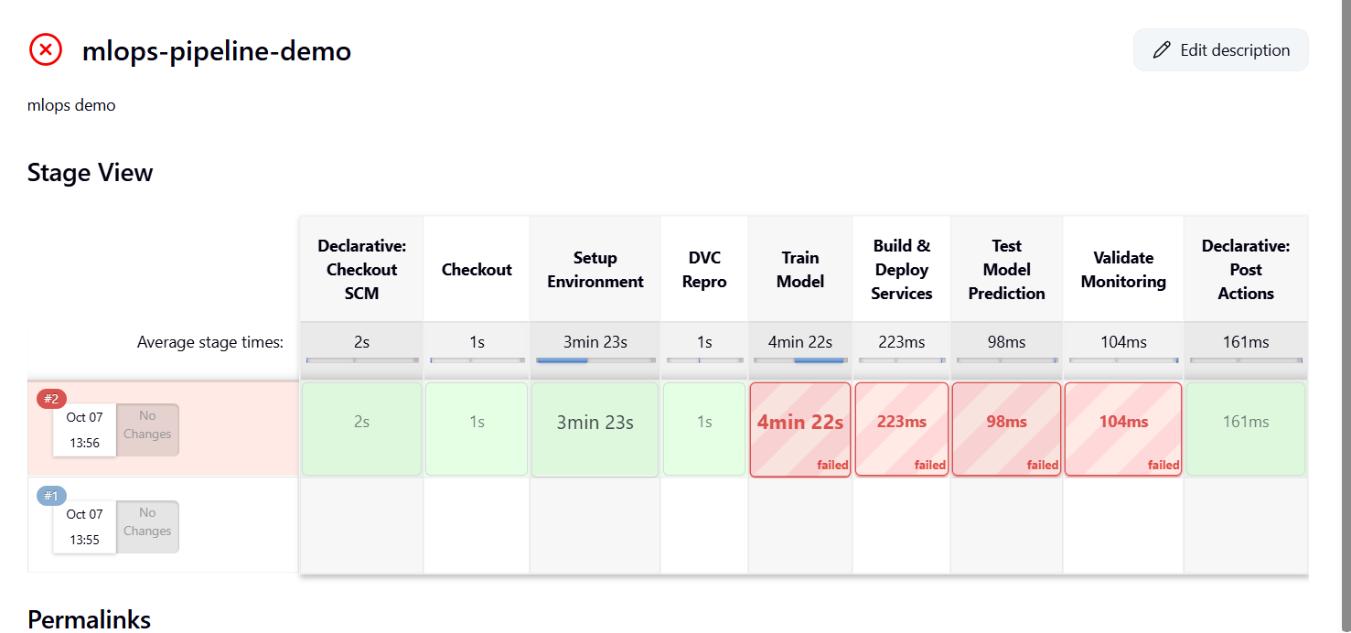

Slide 5
